Slide 1
Quick turnaround data stories
Brian Duggan and Jill Castellano
Reno training, 8.23.17

Slide 2
~Gov’t employees~
Salary rankings: List of employees along with salary, total compensation, DOB, date of hire, title, department, gender, race, etc.
Who makes the most?
What are the attributes of the people making the most? (gender, title, department)
Notes:
Public Employee Database: A great collection of information on public employees for all levels of government (municipal, county, state). This is data that can be utilized in breaking news situations, long-term investigative pieces and to develop sources. Remember to ask for more than just name and compensation in your request. Include DOBs, date of hire, title and department.
Recent Termination Database: Many public agencies maintain a list of recent employee terminations (firings, lay offs, retirements). This is a great place to find sources. Be sure to ask for termination codes.

Slide 3
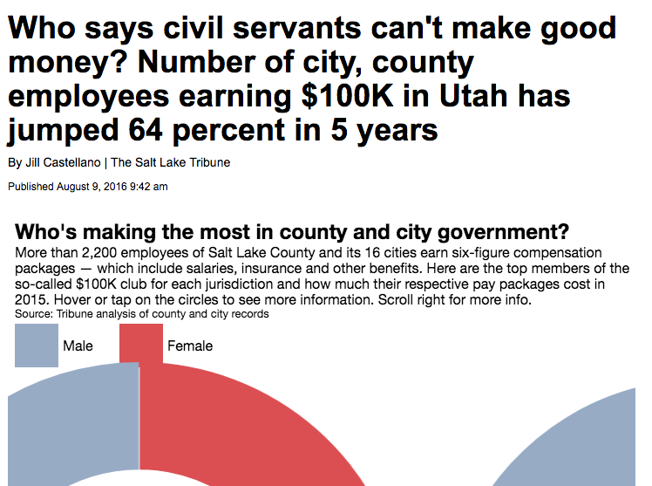
Salary rankings
Notes:
In fact, 32 employees in 2015 made more than $200,000 a year, compared with just two in 2011.
Female executives still lagging in pay: In Salt Lake City, the showing is even worse, with a mere 12 percent of that exclusive group being women. Not far away, in the rapidly growing West Jordan suburb, only two of the 56 employees earning at least $100,000 were women.
Also highly paid: city attorneys, city managers, fire/police officer
http://archive.sltrib.com/article.php?id=4143055&itype=CMSID

Slide 4
~Gov’t employees~
Overtime pay: List of employees, department, overtime pay, etc.
Are there outliers? Is there a department that stands out?
Look specifically at corrections officers – it has led to great stories

Slide 5
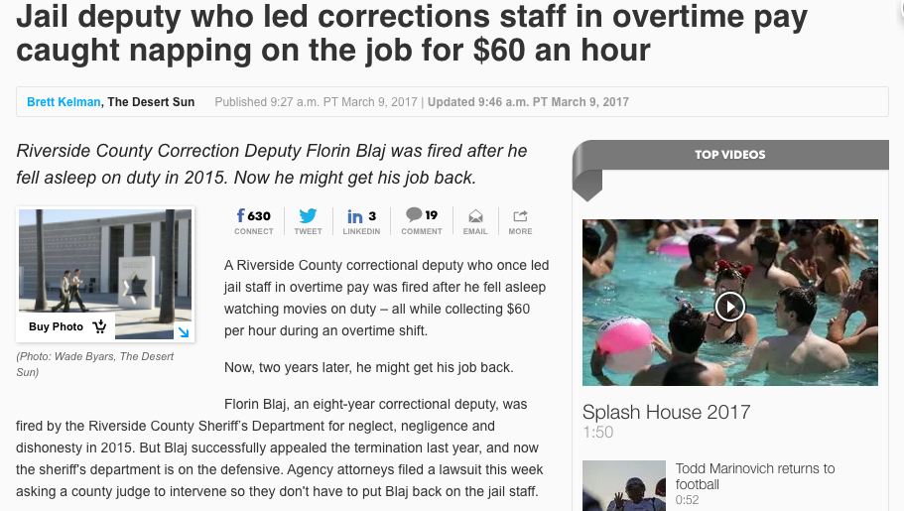
Overtime pay
Notes:
http://www.desertsun.com/story/news/crime_courts/2017/03/09/jail-deputy-florin-blaj/98880894/

Slide 6
~Gov’t employees~
Termination or decertification lists: List of employees recently “terminated”; includes firings, layoffs, retirements
What percent of leaving staff are being fired?
Note: particularly challenging records to get from police departments

Slide 7
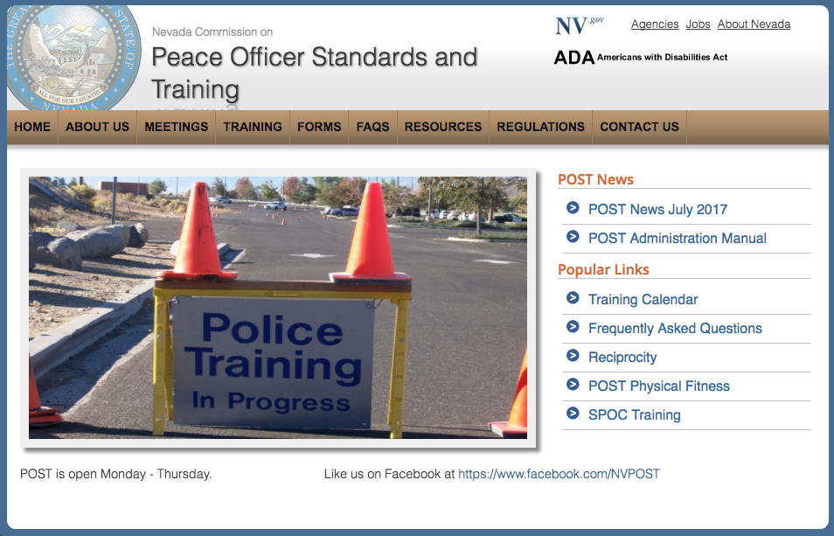
terminations
Notes:
You can ask your state’s police officer agency to give you a full decertification list of officers who’ve lost their jobs

Slide 8
~Transportation~
Airplane delays: FAA data broken down by month, cause and carrier
What airlines cause the most delays?
What months have the worst delays and why?

Slide 9
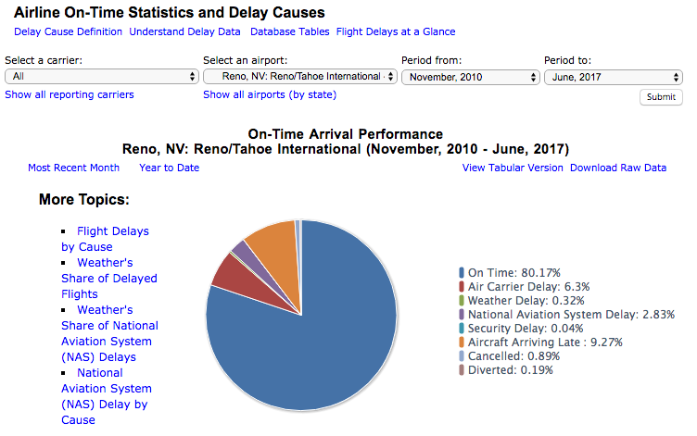
Airplane delays
FAA stats: https://www.transtats.bts.gov/OT_Delay/OT_DelayCause1.asp?pn=1
Notes:
Choose your criteria, download the raw data.
-Possible story: “You’re most likely to face a delay at the Reno airport with these carriers”
-Possible story: Track the percent and total number of delays caused by weather each month or each year and see if it’s getting worse. This is a great story during a snow storm or heat wave that would ground planes.

Slide 10
~Transportation~
FARS data: NHTSA's Fatal Accident Reporting System
What are the most common causes of accidents?
Where are the most accidents taking place?
What vehicles are involved in these accidents? (big rigs, buses?)

Slide 11
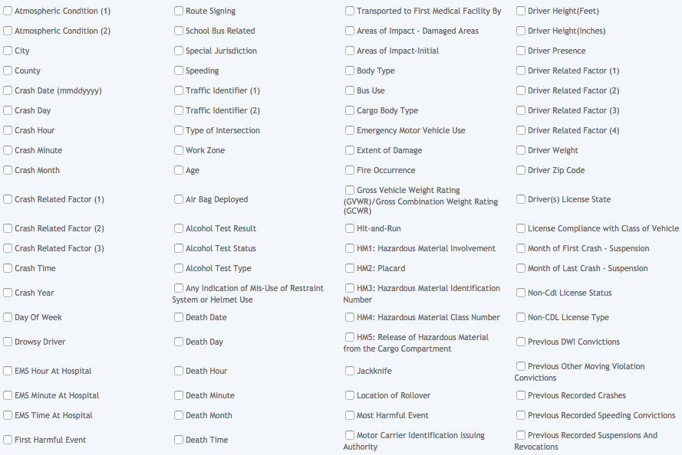
Fars data
https://www-fars.nhtsa.dot.gov/Main/index.aspx
Notes:
Run a query → query tab → submit

Slide 12

Fars data

Slide 13
~Transportation~
Railroad data: Accident and incident data for rail-crossings throughout the U.S.
What are the most common causes of train accidents in your area?
Have their been reports of fatalities?
Notes:
A local idea: Obtain a list of vehicles owned by your city and their make, model, license plate

Slide 14
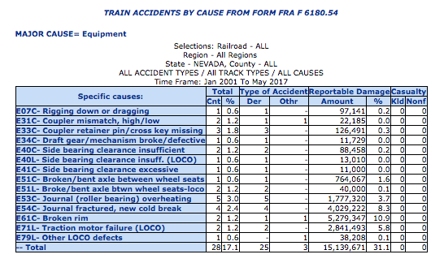
Railroad data
http://safetydata.fra.dot.gov/officeofsafety/
Notes:
Train Accidents
Query FRA Accident Data
Accident Causes
A local idea: Obtain a list of vehicles owned by your city and their make, model, license plate

Slide 15
~infrastructure~
Bridge inspections and dam inspections

Slide 16
~education~

Slide 17
~Demographic data: the census~

Slide 18
~immigration~
TRAC from Syracuse University

Slide 19
~labor~
http://www.osha.gov/oshstats/
US Dept. of Labor OSHA Inspection and Accident Data.

